Slide 1
Maintaining Health and Safety Practices

Slide 2
Health Practices
Performance Standard 1302.41, 1302.47
Minimum Standard 746.3601, 746.3603, 746.3605, 746.3606, 746.3607
Policy Statement:
  UTRGV-PSJA ISD-EHS-CCP Program has the responsibility to preserve the safety, protect the welfare, and promote the physical, mental and emotional health of children, families, staff and volunteers. UTRGV-PSJA ISD-EHS-CCP Grant is responsible for reporting communicable illness and following Universal Precautions.

Slide 3

Health Maintenance
The best defense against a Communicable Disease is a healthy body. A strong Immune system fights off most of the germs that enter the body. When we take care of our bodies with proper nutrition, exercise and rest, our bodies can usually take care of us. Intact skin is an excellent barrier to germs.

Slide 4

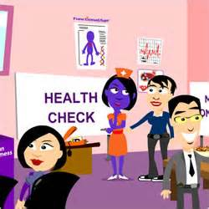
Health Maintenance
All children and adults should have Periodic Health Screenings. This helps in identifying special health care needs and makes treatment to prevent further health problems possible.

Slide 5
What types of illness would prohibit a child from attending the child-care center?
Unless you are licensed to provide get-well care, you must not allow an ill child to attend your child-care center if one or more of the following exists:
  The illness prevents the child from participating comfortably in child-care center activities including outdoor play;
  The illness results in a greater need for care than caregivers can provide without compromising the health, safety, and supervision of the other children in care;
  The child has one of the following (unless a medical evaluation by a health- care professional indicates that you can include the child in the child-care center's activities)
    Oral temperature of above 99.5 accompanied by behavior changes or other signs or symptoms of illness
    Tympanic (ear) temperature above 100 degree
    Axillary (armpit) temperature above 100 degree
  Symptoms and signs of possible severe illness such as lethargy, abnormal breathing, uncontrolled diarrhea, two or more vomiting episodes in 24 hours, rash with fever, mouth sores with drooling, behavior changes, or other signs that the child may be severely ill;

Slide 6
What if a child becomes ill while in care?
Call the parent to pick up the child;
Care for the child apart from other children;
Give appropriate attention and supervision until the parent picks the child up;
Give extra attention to hand washing and sanitation if the child has diarrhea or vomiting.

Slide 7
When may a child who was ill return to my child-care center?
The child is free of symptoms of illness for 24 hours;
You have obtained a health care professional's statement that the child no longer has an excludable disease or condition

Slide 8
How should caregivers respond to an illness or injury that requires the immediate attention of a health-care professional?
Contact emergency medical services (or take the child to the nearest emergency room after you have ensured the supervision of other children in the group);
Give the child first-aid treatment or CPR when needed;
Contact the child's parent
Contact the physician or other health-care professional identified in the child's record;

Slide 9
Cont.
Ensure supervision of other children in the group.
a. If emergency medical services have been contacted it is not necessary to also contact the child's physician unless directed to do so by EMS personnel.
      If parent, legal guardian, or emergency contacts are unable to be located, child will be transported to the emergency room designated on the Child Admission Form under Emergency Medical Authorization
Parents will be given an Incident/Illness (Form 7239) informing them that their child may have been
exposed to a communicable illness or has been injured. The form will be given within 48 hours of the incident/illness. A copy will be kept in the center manager's office. incident/illness. A copy will be kept in the center manager's office.

Slide 10
Head Lice Procedure
Staff will conduct visual daily health checks as the child arrives in the morning.
Staff will escort child to the center manager’s office so he or she can evaluate the health concern. The center manager will inform parent of the concern. If available, treatment may be given to parent to use for child.
The center manager will evaluate the child upon return to class.
Staff will provide Notice to parents within 48 hours to the parent of all children in a group when there is an outbreak of lice.
In the event that health is a concern or a recurring problem, the child will be referred to primary physician and a home visit may be conducted the teacher or case worker.

Slide 11
Safety Practices
Supervision alone cannot prevent all accidents and injuries; therefore the environment must be free of health and safety hazards to reduce risks to children.

Slide 12
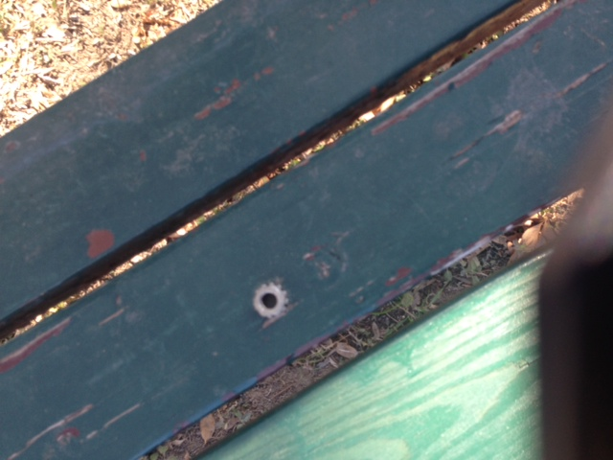
Indoor and Outdoor Equipment
Used both at and away from the child-care center must be safe for the children:
Notes:
a loose nut “oh I’ll take care of it later” and before the end of the day you find out a child had a choking incident and was rushed to the hospital. Could have been prevented….

Slide 13
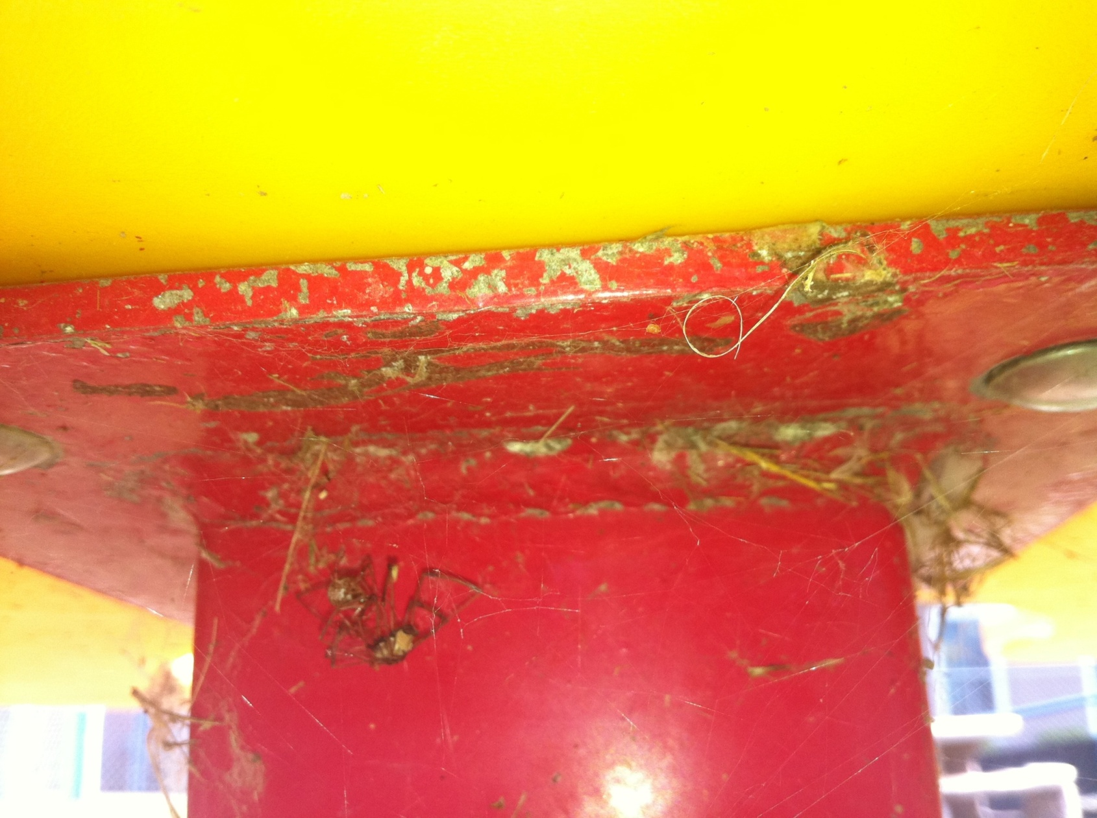
Notes:
13
1). Peeling paint 2). Dead spiders and webs

Slide 14
Notes:
1. showing cleaning supplies in an unlocked cabinet under the kitchen sink that was accessible to children. (actual citation by OAG)

Slide 15
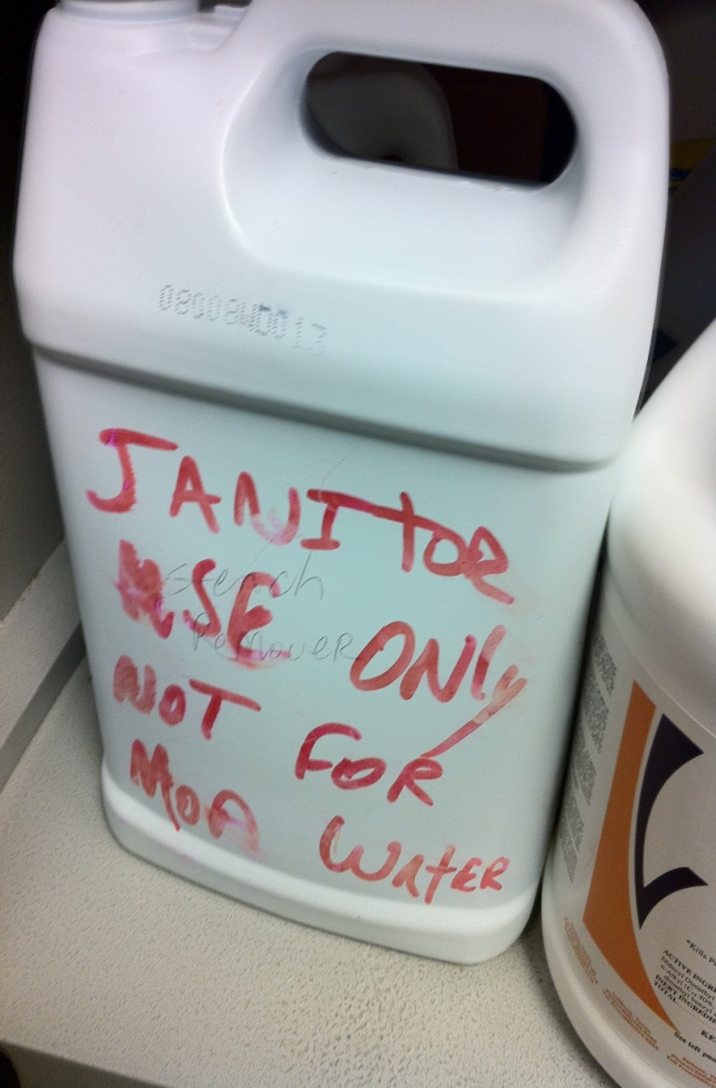
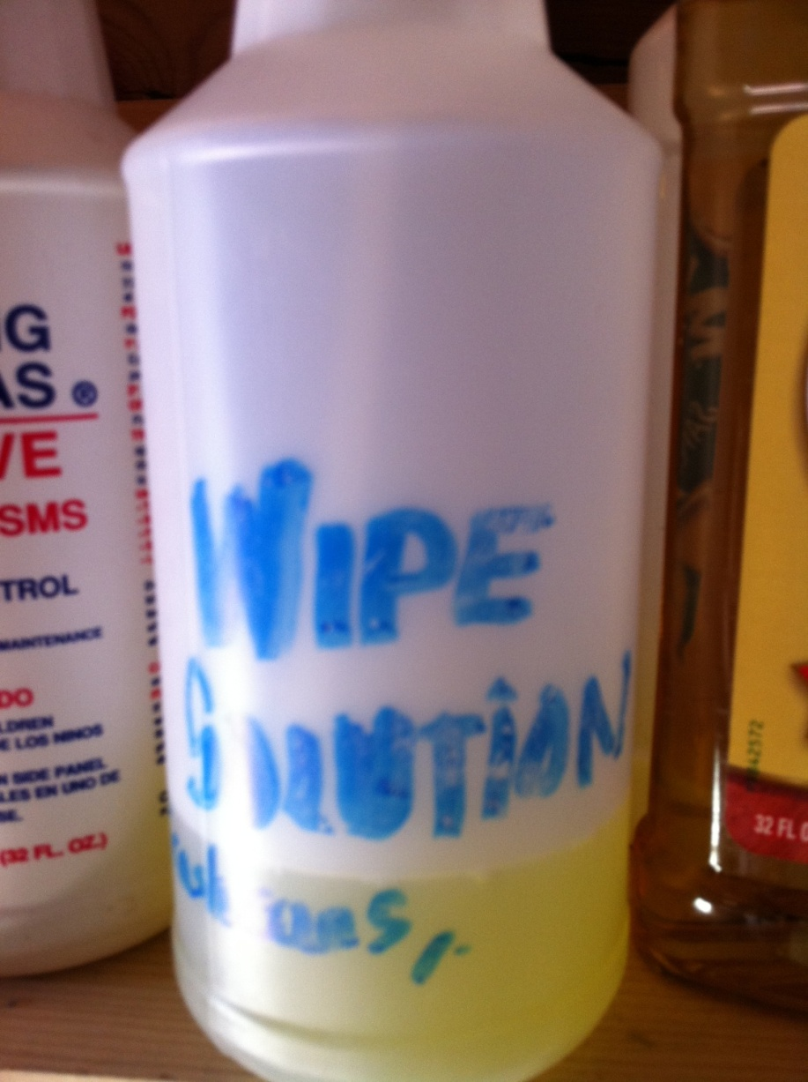
Notes:
1). This is a no no!
What is it and where's the MSDS?

Slide 16
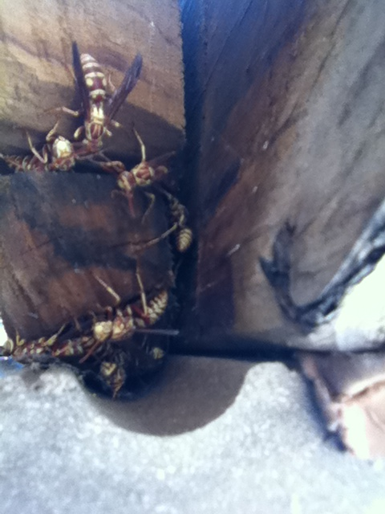
Notes:
16
1). Bees

Slide 17

Notes:
17
Food stored in shelves need to be a minimum of 6” off the floor

Slide 18
Notes:
showing toothbrushes next to the diaper-changing table. (actual citing by OAG)

Slide 19

Safety Practices
  All areas accessible to a child must be free from hazards including, but not limited to, the following:
    Air conditioners, electric fans, and heaters must be mounted out of all children’s reach or have safeguards that keep any child from being injured;
    Play materials and equipment must be safe and free from sharp or rough edges and toxic paints;

Slide 20
Notes:
showing a dust mop next to the water heater and a mop head draped over the heater.

Slide 21
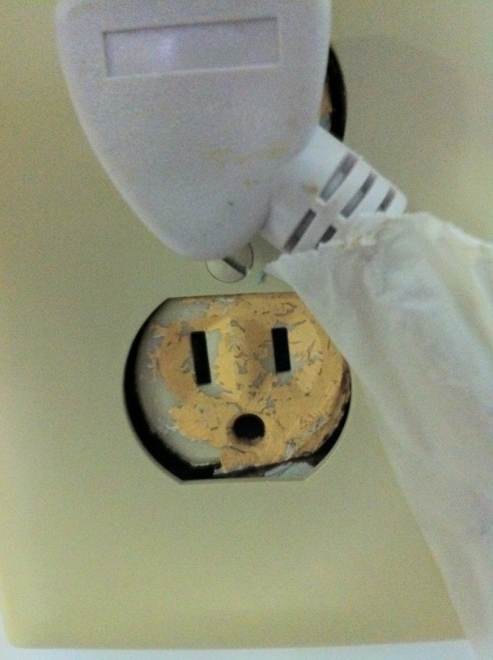
Electrical Outlets must be Covered
Notes:
1). Over the outlet 2). Consider purchasing outlet covers that automatically cover 3). Do not forget the surge protectors they too need to be covered

Slide 22
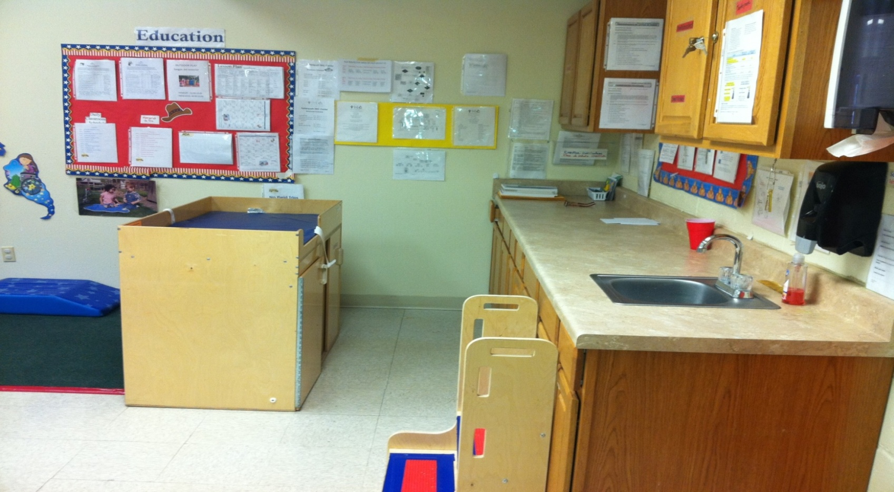
Where’s the diapering sink?
Notes:
1). There needs to be one sink designated for diapering 2). If serving infants one sink for food prep 3). One sink for oral hygiene and general hand washing. Therefore infant rooms need at least 3 sinks. While toddler rooms which have a diapering table need 2 sinks.

Slide 23
Any questions?

